Slide 1


Liberty Lake
Climate Partners Advisory Team—Meeting 1
Note – images sourced as “Courtesy” may need request if used for final document…other images from 2016 Comp Plan

Slide 2
Agenda
Agenda
Welcome and Introductions
Charter Review and Approval
Climate Element Overview
Greenhouse Gas Inventory, Explanation, and Discussion
Creating a Vision Statement
Next Steps

Slide 3
CHARTER REVIEW

Slide 4
OVERVIEW OF CLIMATE ELEMENT

Slide 5
What is the “Climate Element”?
What is the “Climate Element”?
RCW 36.70A.070 Comprehensive plans—Mandatory elements.
“A climate change and resiliency element that is designed to result in reductions in overall greenhouse gas emissions and that must enhance resiliency to and avoid the adverse impacts of climate change, which must include efforts to reduce localized greenhouse gas emissions and avoid creating or worsening localized climate impacts to vulnerable populations and overburdened communities.”
https://app.leg.wa.gov/RCW/default.aspx?cite=36.70A.070&pdf=true
  Washington State now requires planning for climate change in the Comprehensive Planning process.
  Climate Element includes two sub-elements
  GHG Emissions Reduction sub-element
  Resilience sub-element
  Communities are also required to advance environmental justice and avoid environmental health disparities.
Notes:
This is mostly a background slide, and I included this at the open house that many of you attended.
They key information here is that for Anacortes, both the GHG emissions and the Resilience subelement are required.
There are also new requirements to meet environmental justice goals, and reduce impacts for vulnerable populations and overburdened communities.
We are in the process of forming a Climate Policy Advisory Team (CPAT) which will help guide the development of the Climate Goals and policies. We are working to include members that are part of or work with these populations in Anacortes – the CPAT will be one of the primary ways we ensrure alignment with those EJ goals.
We are also happy to discuss EJ goals with staff at these meetings.

Slide 6
Process Overview
GHG inventory
Analysis/ Assessment
Data Gathering
Identify emissions reduction targets
Establish Goals
Plan Integration
Climate Element goals/policies
Integrated Comprehensive Plan
GHG Emissions Sub-element
Assess impacts and review existing plans
Assess vulnerability
Resilience
Sub-element
Other Comprehensive Plan Elements
Updates to other comprehensive plan elements
Engagement
Community engagement activities at key points throughout the process

Slide 7
GREENHOUSE GAS (GHG) EMISSIONS SUB-ELEMENT

Slide 8
Why do we care about GHGs?

Slide 9
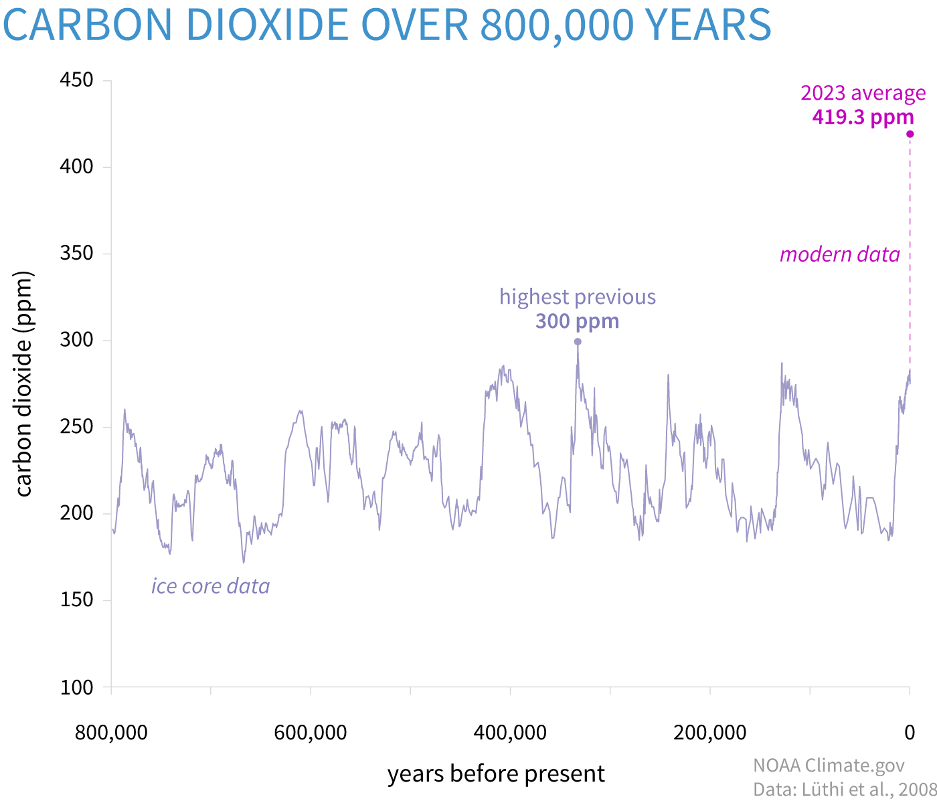
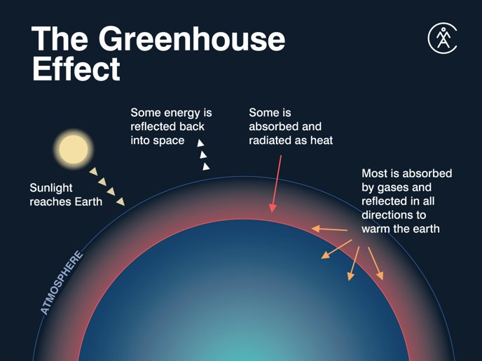
GHG 101
Notes:
Make sure to mention that this is a mandated element

Slide 10
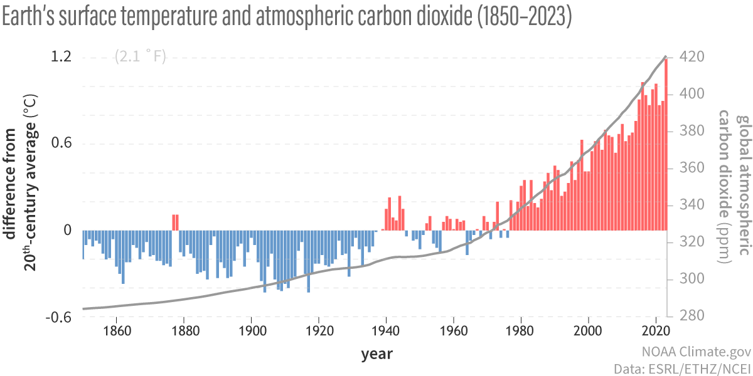
GHG 101
Notes:
Make sure to mention that this is a mandated element

Slide 11
What does this mean for Liberty Lake?
Hotter days roughly 10 days over 100 per summer by 2070
Warmer nights roughly 35 nights over 65 per summer by 2070
Lower snowpack Mica peak loses 97% of snowpack by 2080s
More drought consecutive dry days goes from 27 to 33 by 2070
More wildfire more smoke, more economic and environmental disruption
More extreme winter precipitation 24% increase in the intensity of heavy rainfall (2 year storm) by 2080s
Notes:
Make sure to mention that this is a mandated element

Slide 12
Liberty Lake’s GHG Inventory

Slide 13
What is a GHG inventory?
Accounting of greenhouse gases (GHGs) emitted to or removed from the atmosphere during a specified period for an organization or geographic boundary.
GHGs are in large part from the combustion of fossil fuels, but also include emissions from other sources like refrigerants, wastewater treatment, waste disposal, and land use change.
GHG inventories provide an emissions baseline and a means to track emissions reductions over time and progress toward goals.
Greenhouse Gas | Chemical Formula | Global Warming Potential (GWP)
Carbon Dioxide | CO₂ | 1
Methane | CH₄ | 28
Nitrous Oxide | N₂O | 265
Other high-GWP gases | CFCs, HFCs, SF₆, etc. | up to 24,000
Source: IPCC 5th Assessment Report, 2014, 100-year values
Notes:
Make sure to mention that this is a mandated element

Slide 14
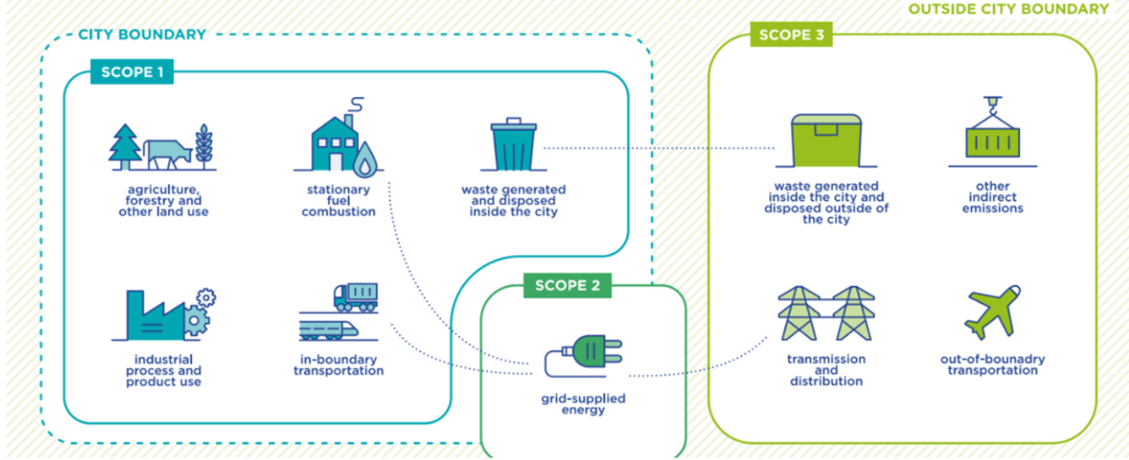
What’s included?
Includes activities within calendar year 2022
Activities within the city’s geographic boundary
Follows Washington State Department of Commerce requirements
Includes all residential energy sources, transportation, waste, and the conversion of land to make the city in the first place.
Notes:
This is based on the Global Protocol for Communities put out by the IPCC

Slide 15
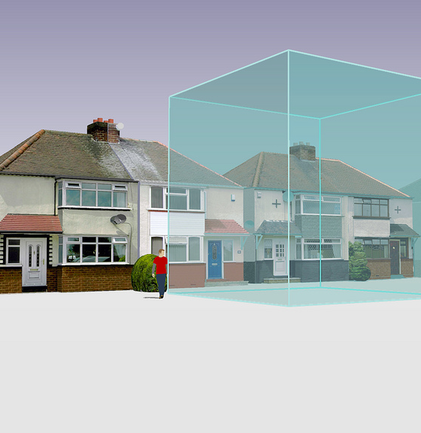
What is 1 MT CO₂e?
A Metric Ton of Carbon Dioxide Equivalent – a way to normalize GHG gases to CO₂.
One MT CO₂e is equal to any one of the following:*
One passenger vehicle driven 2,500 miles
13% of one US home’s energy use for a year
46 propane cylinders for home BBQs
1.2 acres of forest sequestration for 1 year
*Calculated using EPA’s GHG Equivalencies Calculator

Slide 16
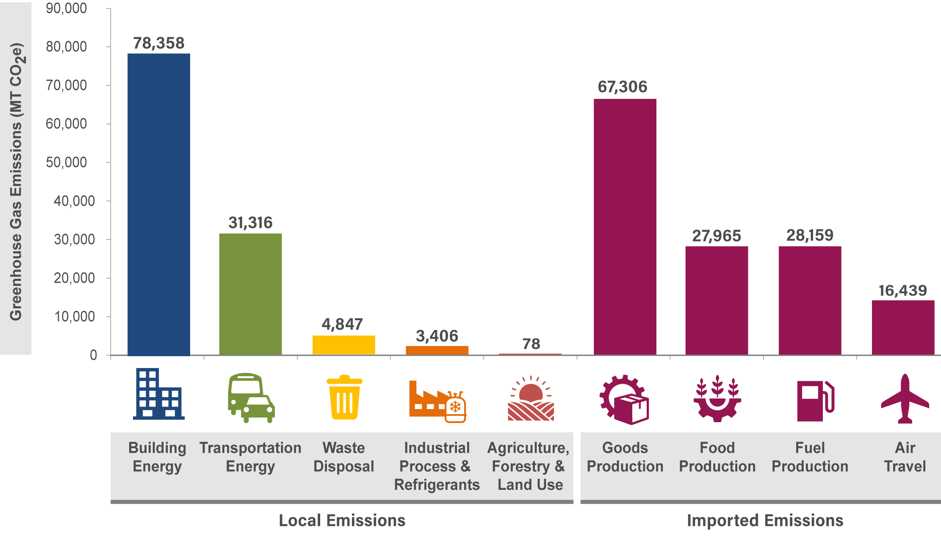
Overall Results for 2022: 257,875 MT CO₂e

Slide 17
Per-Capita Comparison—Local Emissions
Liberty Lake is primarily residential:
No Industrial
No Agricultural
Not a lot of outside traffic coming in
Notes:
The state of Washington’s GHG inventory

Slide 18
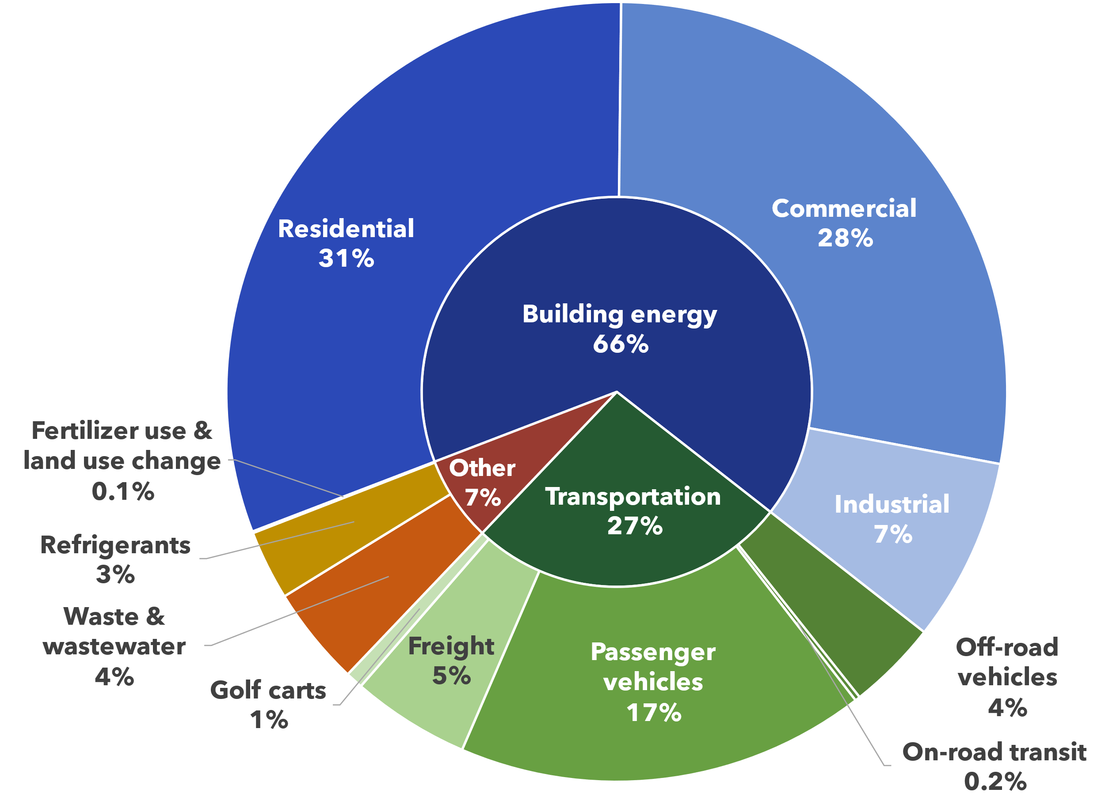
Overall Results—Local Emissions

Slide 19
Building Energy (66%)
Includes any energy used in buildings, including:
Lights
Heat/Cooling
Appliances
Data Sources for building energy emissions:
Electricity (38%)
Avista Energy
Utility Bills
Solar decreases usage
Renewable Energy Credits (RECs) subtracted from total
Electric vehicle (EV) electricity included in Transportation
Natural Gas (24%)
Avista Natural Gas
Utility Bills
Other (4%)
Propane
Diesel
Estimated based on state averages

Slide 20
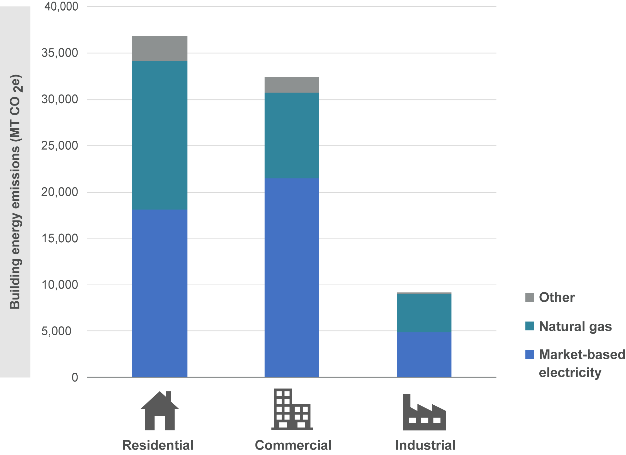
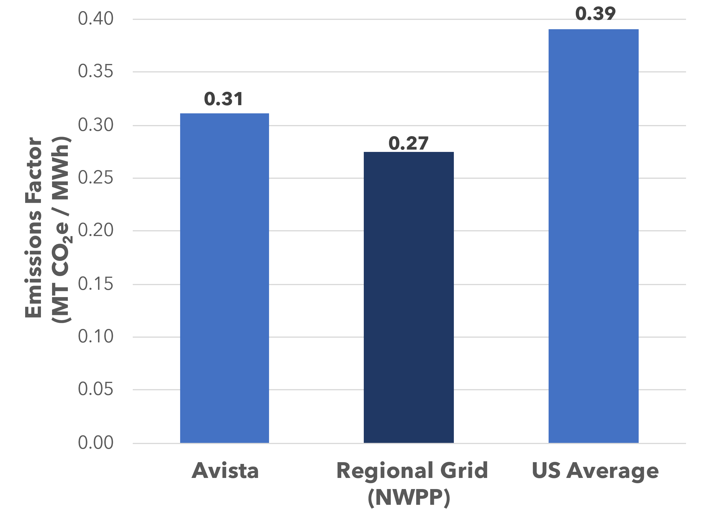
Building Energy (66%)
Emissions Factors –
Market- vs Location-Based
Avista Energy is in line with the regional average

Slide 21
Transportation Energy (27%)
Includes any energy that fuels transportation
Passenger Cars
Freight
*No significant rail
Data Sources for transportation emissions:
Passenger Cars and Freight (22%)
Replica software – Vehicle miles traveled (VMT) estimate from cell phone data
Passenger car population from DMV
Department of Energy fuel efficiency estimates
Spokane Transit Fuel Usage
Golf Carts (1%)
Golf course estimates
  Number of carts
  Fuel budget
City registered golf carts
Off Road (4%)
Lawnmowers
Construction Equipment
ATVs
Estimated from statewide inventory
Notes:
A lot of this comes from AFLEET – This is really a tool designed to help government agencies understand when it’s time to buy new vehicles, when is it cost effective is the biggest thing that they focus on

Slide 22
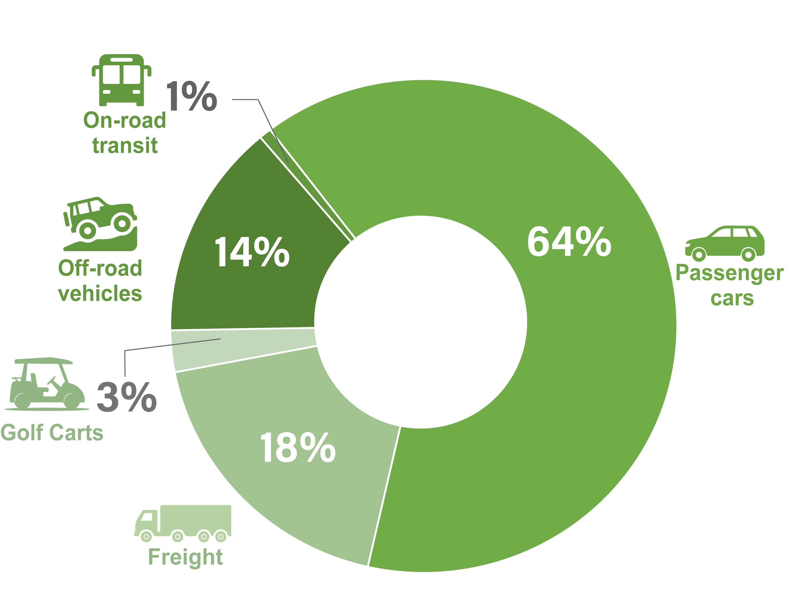
Transportation Energy (27%)

Slide 23
Waste and Refrigerants (7%)
Includes the following:
All community refrigerant use
Landfilled waste
Water treatment/process emissions
Data Sources for waste and refrigerant emissions:
Refrigerants (3%)
Air Conditioners
Cars
Refrigerators
Industrial Cooling
Downscaled from EPA data
Solid Waste (1%)
Garbage collected in the city
Taken to Greater Wenatchee Landfill
Proportion of landfill’s emissions based on tons of waste
Compost Emissions
Wastewater (3%)
Local Wastewater Treatment
Out of Town Wastewater Treatment
Estimated by EPA’s community inventory tool
N₂O emissions
CH₄ emissions
Notes:
Refrigerants Freon replaced with R410 “Pureon”
Talk about compost here—There are emissions associated with Compost, but they are less than it would be to landfill an equivalent quantify of waste, and although those emissions are associated with your community, they are also offset

Slide 24
Land Use and Land Use Change (0.1%)
Includes the following:
Golf course fertilizer use
Historical emissions from development
Data Sources for land use emissions:
Fertilizer Use (<0.1%)
Golf course reported fertilizer usage
N₂O emissions per ton of N fertilizer
Development (<0.1%)
Previous area assumed to be rangeland
Emissions per acre from EPA factors
Split up over 20 years.
Last inventory to count

Slide 25
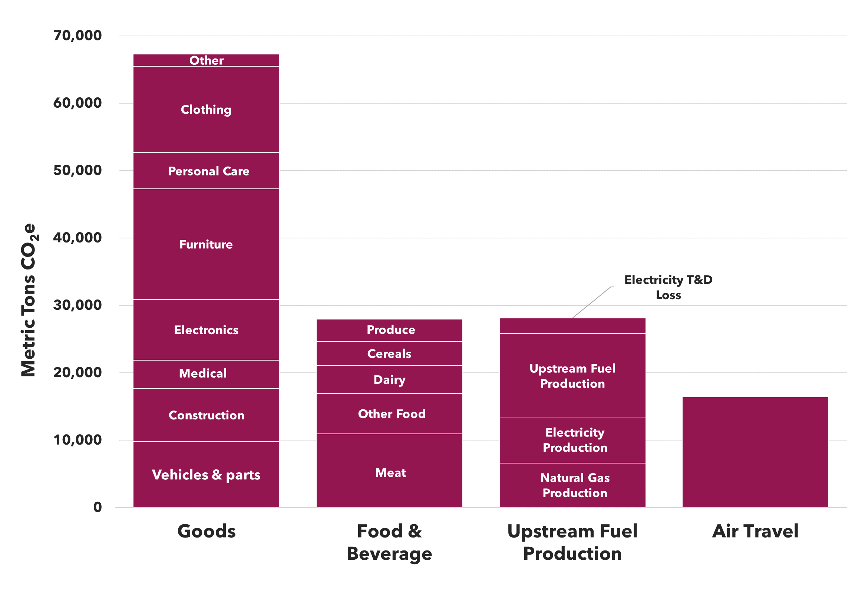




Imported Emissions: roughly equal to local
Food, Goods, and Air Travel based on income
Data Source: US Census
Data Source: Berkeley CoolClimate Calculator
Fuel production based on electricity, natural gas, gasoline, and diesel usage
Data Source: State-wide and national fuel production averages

Slide 26
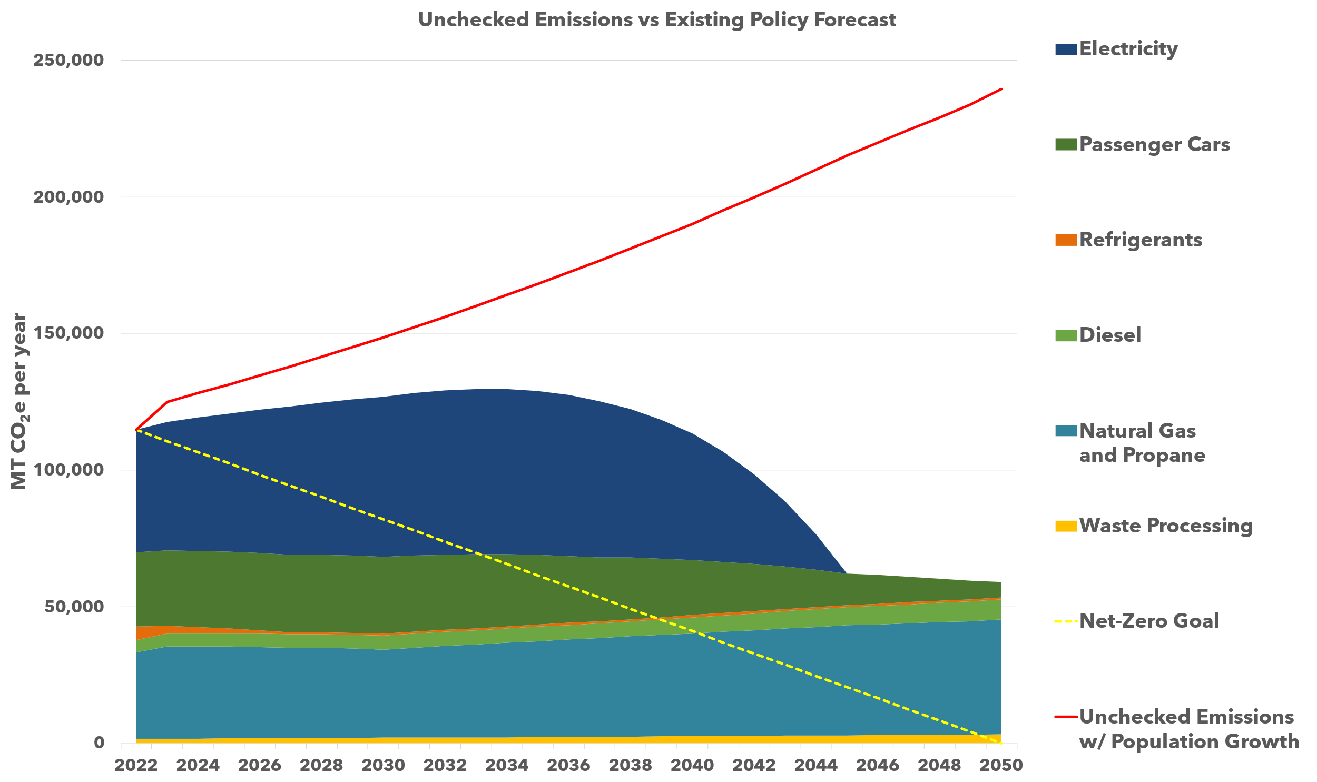
Emissions Forecast: Fast Growth vs. Reductions
Recent growth exceeds growth projections
Electricity: Washington Clean Energy Targets require Electricity emissions go to zero by 2040
Electricity and Natural Gas: Clean Buildings act requires increases in building efficiency
Fuels: Clean Fuels Standards require transportation fuel emissions decrease by 20% by 2034
Passenger cars: All new cars sold must be EVs by 2035
Refrigerants: State of Washington HFC Rules phase out high GWP chemicals

Slide 27
Next Steps

Slide 28
Process Overview
GHG inventory
Analysis/ Assessment
Data Gathering
Identify emissions reduction targets
Establish Goals
Plan Integration
Climate Element goals/policies
Integrated Comprehensive Plan
GHG Emissions Sub-element
Assess impacts and review existing plans
Assess vulnerability
Resilience
Sub-element
Other Comprehensive Plan Elements
Updates to other comprehensive plan elements
Engagement
Community engagement activities at key points throughout the process

Slide 29
Set Goals, Develop Policies
Develop goals and policies to support the following:
Reducing building energy/increasing efficiency
Smart growth policies
Reduce diesel emissions
Support EV transition
Support clean electricity
Reduce reliance on natural gas
Reduce reliance on passenger vehicles

Slide 30
CREATING A VISION STATEMENT
Develop a vision statement describing the social, economic, and environmental places, traditions, and values that matter most to the Liberty Lake community.
Notes:
From the charter, one of the CPAT’s responsibilities is to:
“Develop a “vision statement” describing the social, economic, and environmental places, traditions, and values that matter most to the Liberty Lake community.”
Whiteboard brainstorming activity – have people popcorn ideas, group ideas loosely
Places
Traditions
Values
Other

Slide 31
NEXT STEPS
Notes:
Next CPAT meeting – date and what will be covered
Workshops this week – buildings and transportation
Mitigation measures list

Slide 32
THANK YOU!

