Slide 1
Facility Comparables
Facility Committee
June 17, 2015

Slide 2
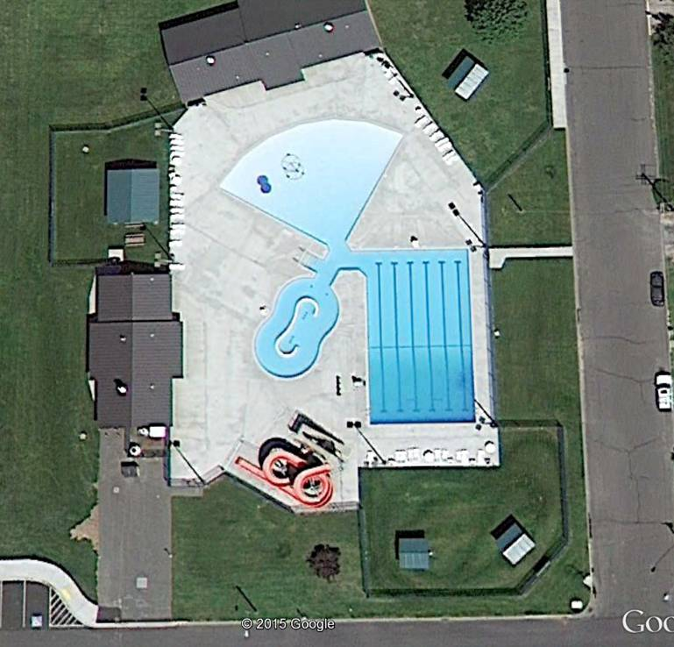
Othello Community Pool
Features: Leisure amenities: including a 2,800-square-foot leisure pool, lazy river and spray park that complement a traditional 25-yard outdoor pool.
Cost: $2.6 million
Aquatic space: 24,000 square feet
Notes:
With a population of 7,290 Othello, WA staff felt this was a good example to show for a comparable size community outdoor community pool.

Slide 3
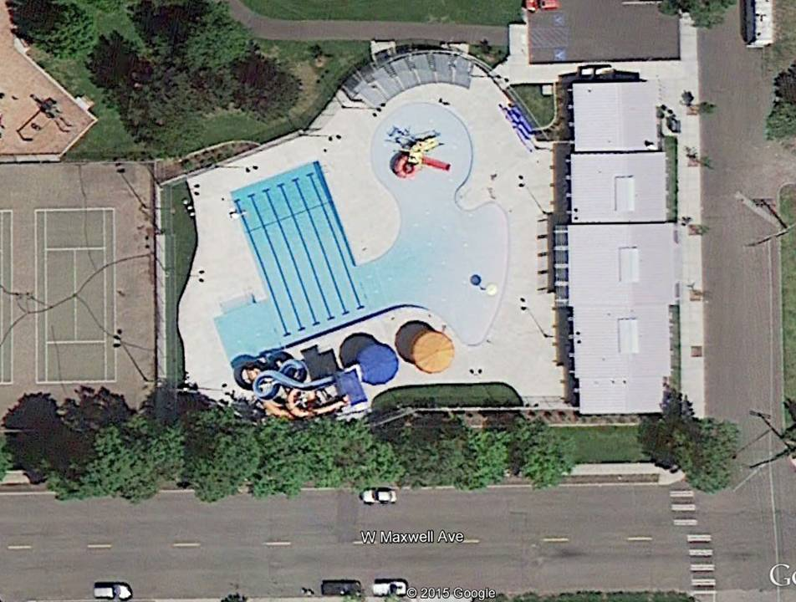
Cannon Community Pool
Features: two water slides, play features with zero-depth entry and a 6-lane, 25-yard pool and new bathhouse.
Cost: $3,339,400
Aquatic Space: Approx. 25,000 sq. ft. of aquatic space (water & deck area)
Notes:
Spokane,WA population of 210,721 (2013).

Slide 4
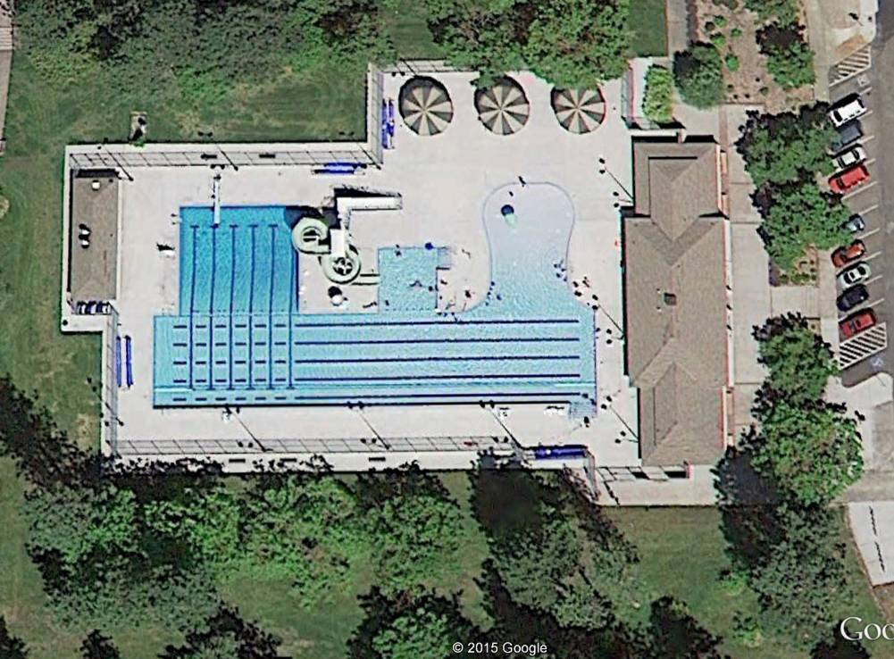
Comstock Community Pool
Features: 6 Lane 25 Yard Lap Pool, 4 lane 50 Meter Lap Lanes, Recreation Swim Area, Zero Depth Entry, Play Features
Cost: $2,533,600
Aquatic Space: Approx. 28,000 sq. ft. of aquatic space (water & deck area)
Notes:
Spokane, WA population of 210,721 (2013).

Slide 5
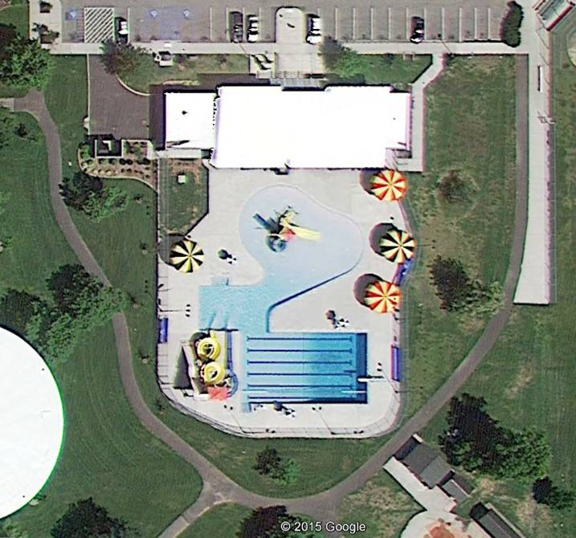
Shadle Community Pool
Features: 6 Lane 25 yard lap pool, recreation swim area, zero depth entry, play features and two water slides
Cost: $3,306,900
Aquatic Space: Approx. 22,000 sq. ft. of aquatic space (water & deck area)
Notes:
Spokane, WA population of 210,721 (2013).

Slide 6
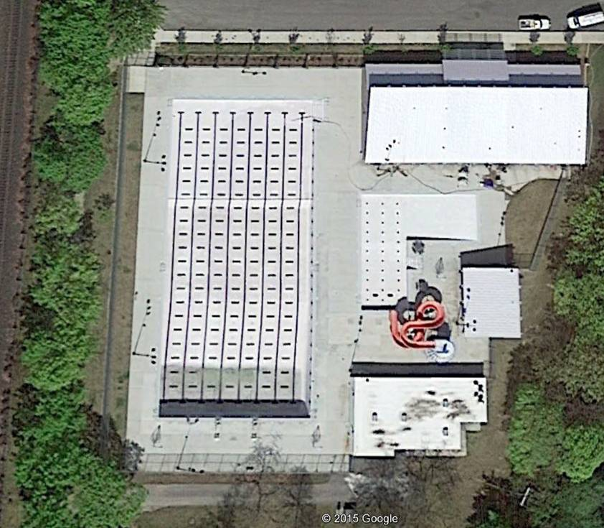
Witter Community Pool
Features: 50 meter competition pool, recreation pool, water slide, zero depth entry and birthday/meeting rooms
New/partial remodel
Cost: $3,699,800
Aquatic Space: Approx. 32,000 sq. ft. of aquatic space (water & deck area)
Notes:
Spokane, WA population of 210,721 (2013).

Slide 7
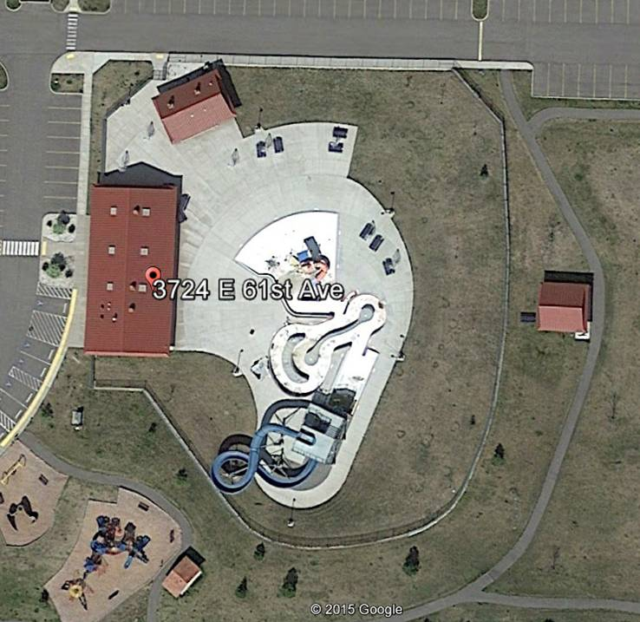
Southside Aquatic Center
Features: Heated outdoor pool with waterslide, water cannons, playground & concessions, open seasonally.
Cost: $5,000,000
Aquatic Space: Approx. 26,000 sq. ft. of aquatic space (water & deck area)
Notes:
Spokane, WA population of 210,721 (2013).

Slide 8
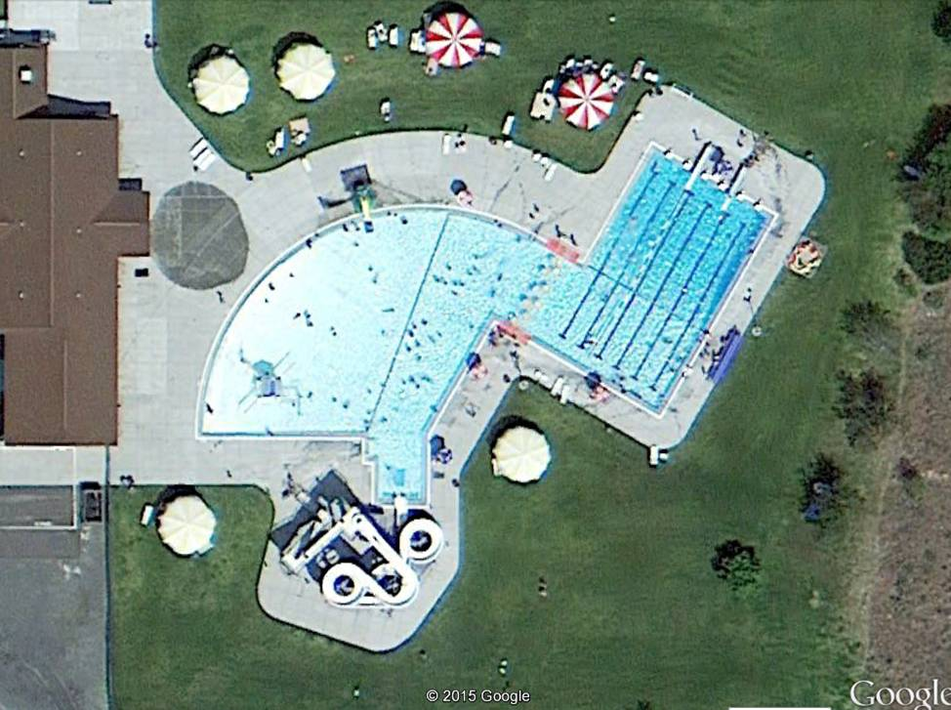
Ephrata Splash Zone
Features: zero depth beach area entry, 251 foot long slide, and competition pool, children's interactive play area, rope net climbing feature.
Cost: $2,003,479
Aquatic Space: 30,000 square feet (water & deck area)
Notes:
Ephrata, WA population of 7,959 (2013).

Slide 9
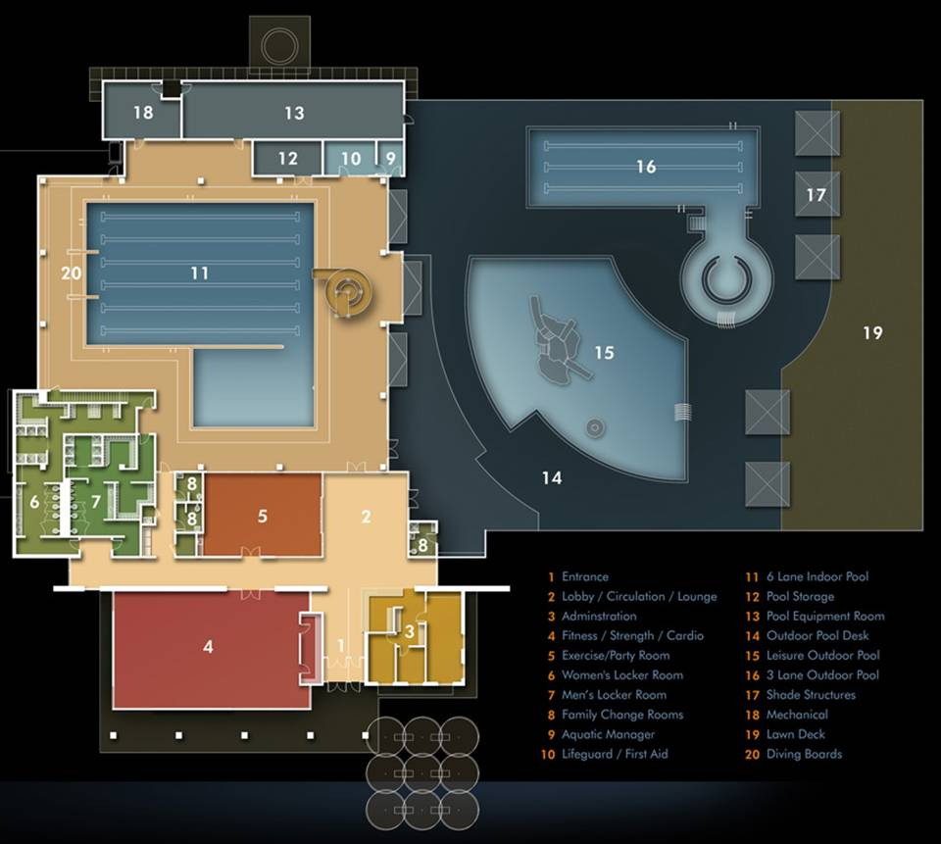
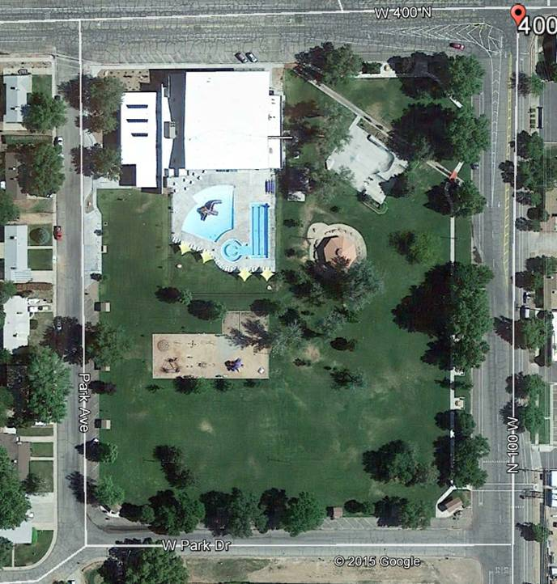
City of Moab, Utah Recreation and Aquatics Center (indoor/outdoor)
Notes:
Moab, UT population of 5,130 (2013).

Slide 10
City of Moab, Utah Recreation and Aquatics Center (indoor/outdoor)
Features:
Indoor 6-lane competition pool, shallow-water area and 18' slide, Outdoor 3-lane lap pool with adjoining (lazy river) and bubble pool, Expansive outdoor leisure pool with zero-entry depth, play structure with slides, and fountains
Multi-purpose room available for rental for pool parties, events, and social gatherings, 2400-square-foot fitness center with free weights and cardio machines, Child care center
Notes:
Moab, UT population of 5,130 (2013).

Slide 11
City of Moab, Utah Recreation and Aquatics Center (indoor/outdoor)
Cost: Approx. 6.4 Million to 7.1 million (2009) Capital Cost
Aquatic Space: Approximately 24,000 sq. ft. indoor facility with approximately 14,000 sq. ft. of indoor aquatic space (water & deck area) plus approximately 18,000 sq. ft. of outdoor aquatic space (water & deck area)
Notes:
Moab, UT population of 5,130 (2013).

Slide 12
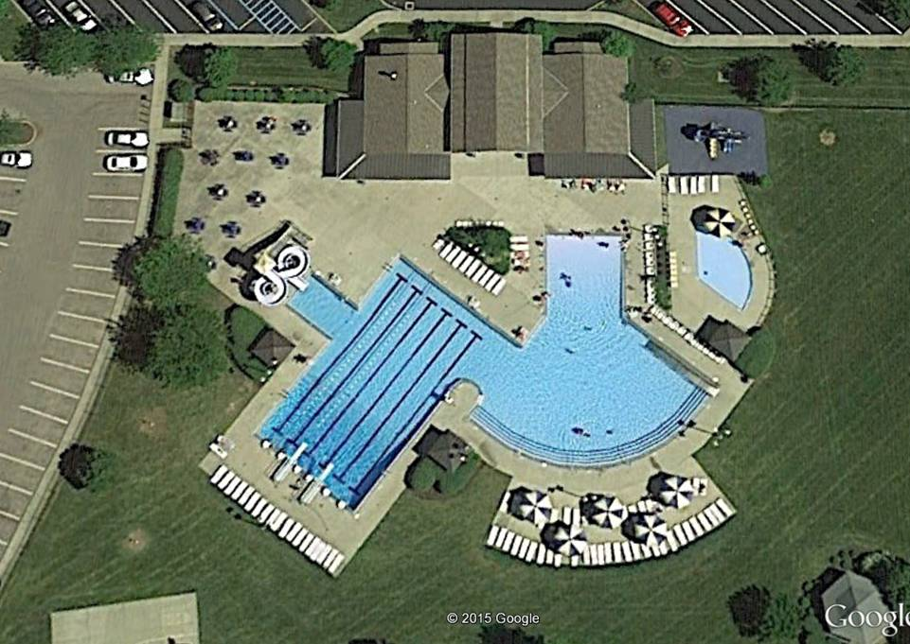
Montgomery, OH City Pool
Amenities: zero depth entry, bathhouse, showers, lap swimming, slide, and wading pool
Cost: 225,000 O&M
Aquatic Space: 27,000 square feet (water & deck area)
Notes:
Montgomery, OH population of 10,366 (2013).

Slide 13
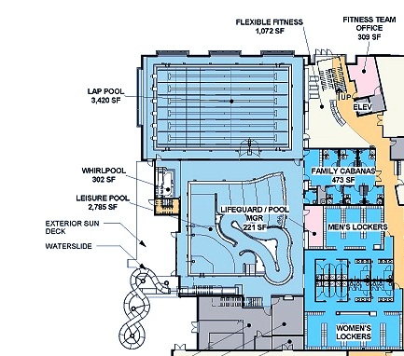
Sammamish Community Center
Amenities: lap pool, lazy river, slide, whirl pool, locker rooms, cabanas, Splash Park, Jacuzzi
Cost: $33,885,000
Aquatic Space: 10,700 square feet of pool
Notes:
Sammamish, WA population of 50,169 (2013).

Slide 14
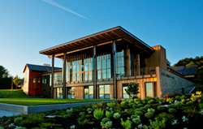
Mukilteo Rosehill Community Center:
Rental for Special Events
Accommodates groups of 10 to 450
Catering-ready kitchen
Wi-Fi, access to LCD projectors
Microphones, adjustable lighting

Slide 15
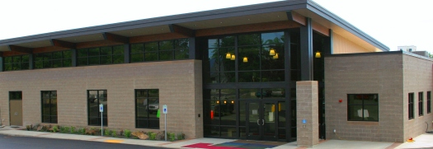
Cheney Wren Pierson Community Center
Used for:
Cheney Food Bank
Clothing Exchange
Cheney Outreach Center
EWU/Cheney SCOPE.
Private rental events

Slide 16
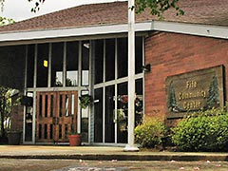
Fife Community Center
Amenities: Special Events
Banquet room that can be divided by solid partitions into three separate rooms, Kitchen with back door access, rental equipment.
City uses center for public meetings, open houses, city department meetings, senior programs
(Built in 1978)
Square Ft: 11,000

Slide 17
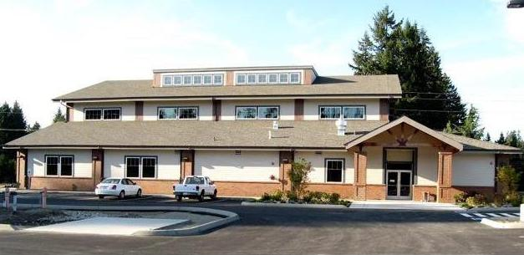
Lacey Community Center (Constructed in 1996)
Special Events
Rental equipment available for every occasion
Fully stocked kitchen
Cost: $1.6 Million
(included the parking lot and trail along the pond shoreline)
Square Ft: 9045

Slide 18
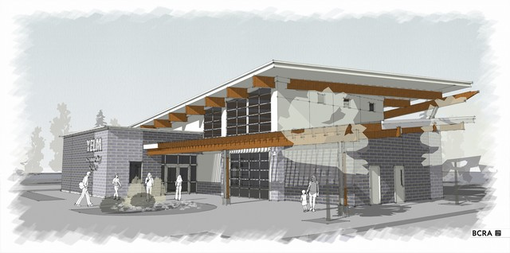
Yelm Community Center (Under Construction 2015)
3,300 square feet of multi-purpose space which will accommodate events of up to 250 people
Full commercial kitchen
Pass through into Yelm City Park
Exterior restrooms to serve general park users.
Cost: $1,879,869
(bid from Stetz Construction)
Square Ft: 5000

Slide 19
http://www.libertylakewa.gov/391/2015-Community-Task-Force

